Slide 1

Sauce&Spoon’s tabletop menu tablets

Slide 2
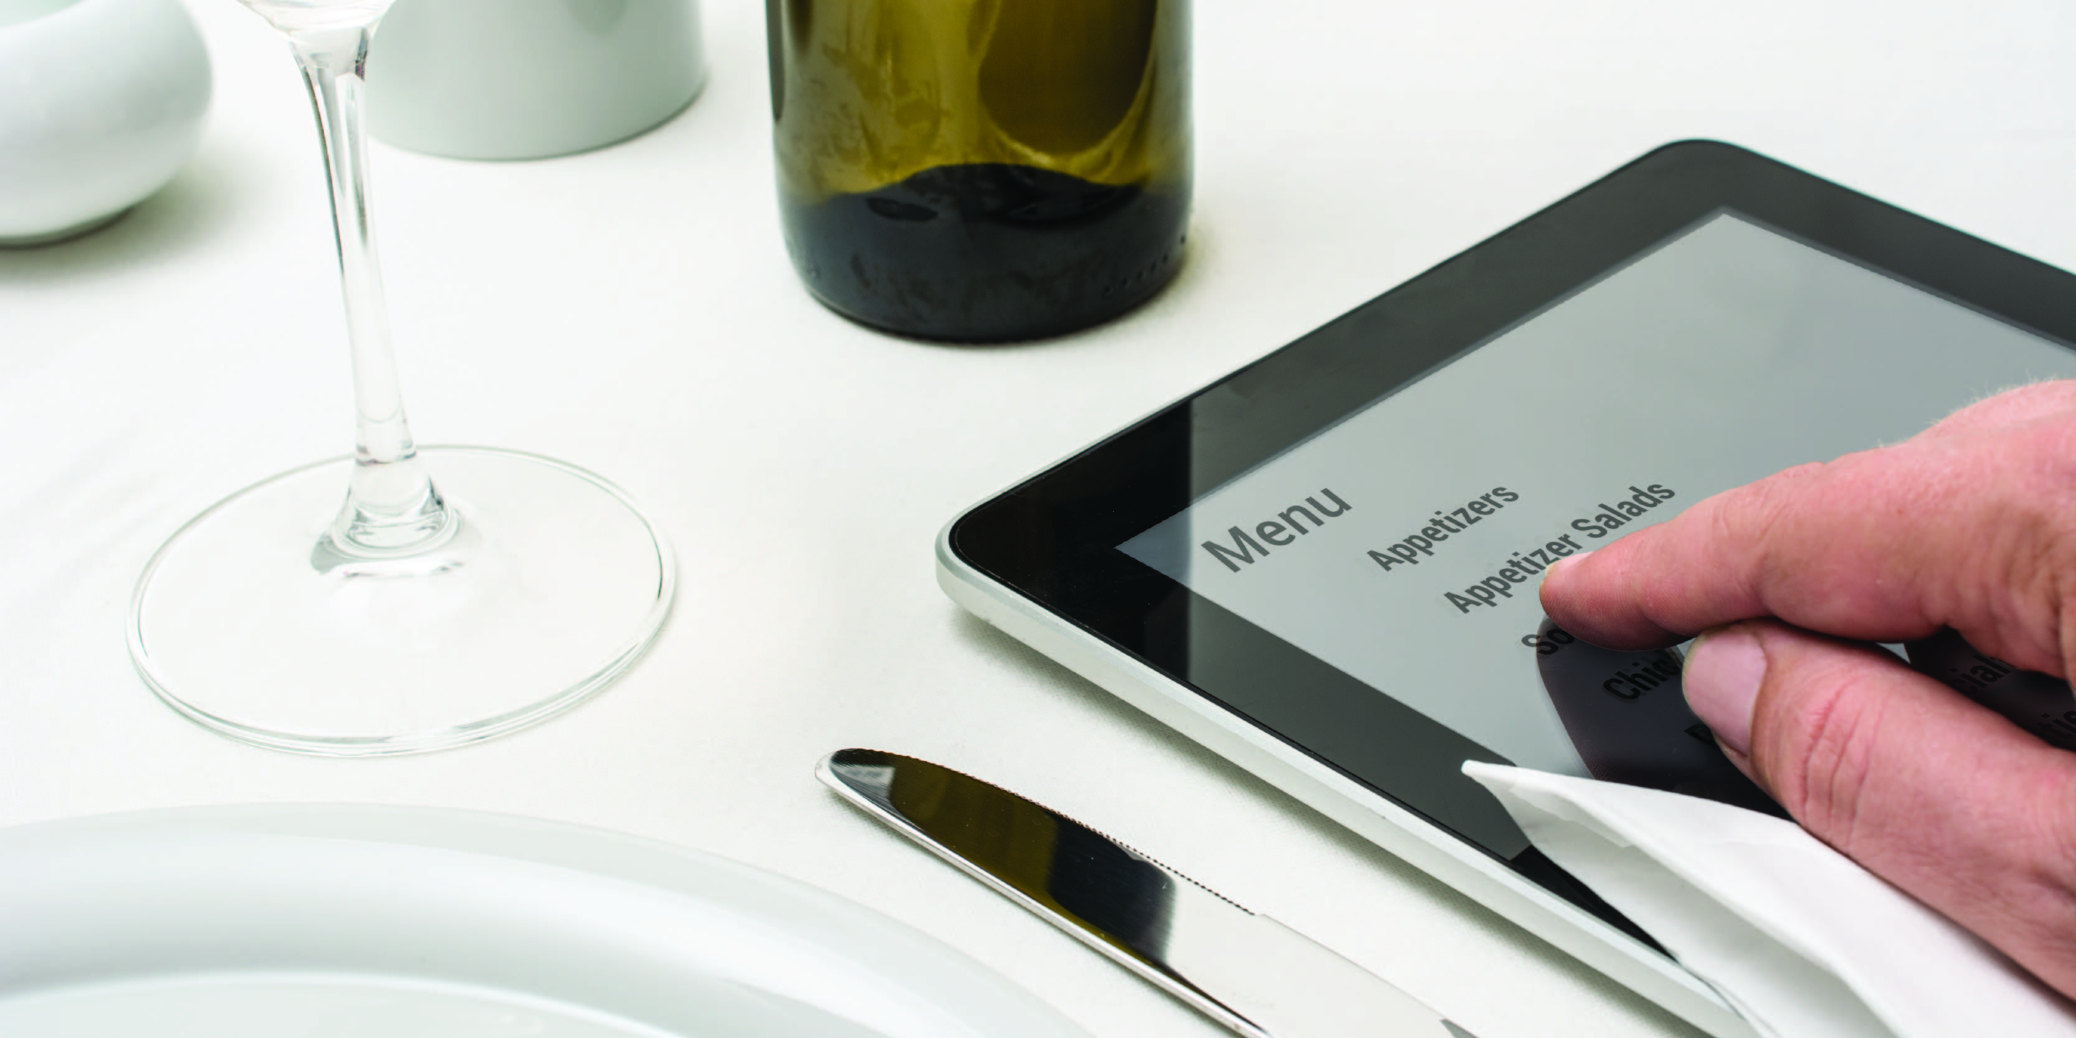
Summary
The idea of project is to launch a pilot rollout of tabletop menu tablets at two locations (S&S North and S&S Downtown) at the bar section of each restaurant.
It will help to order meals, drinks promptly without waiting for a server and pay for services as well.

Slide 3
Overview
To increase the product mix (upselling appetizers or specialty drinks or coupons) by 15%
To decrease average table turn time by about 30 minutes
To increase our daily guest counts by 10%
To modify a menu item to cut amount of food waste by 25% by the end of Q2 considering the metrics from kitchen
To set up a training for staff on the new system (TBD)
To integrate the tablets with existing POS system and host software
To increase average check value from 65$ to 75$ for each table
To improve the satisfaction of the kitchen staff

Slide 4
Findings
The project launched on time, but some internal activities have been rescheduled
Not enough time to cover all the activities

Slide 5
Next Steps
To come up with system updates
To implement a possibility to pay by cash
To have a new training for staff

